Slide 1
Obesity Levels Prediction
Daud Rusyad Nurdin
DA/DS Bootcamp batch 34
Final Project

Slide 2
Table of Contents
04
Building Model
02
03
☑ Data Understanding ☑ Exploratory Data Analysis ☑ Data Preprocessing
2
00
Introduction
01
What and Why Obesity?
05
Project Background and Problem Statement
Streamlit App Development
06
Conclusions and Business & Actionable Insights
Data Preparation

Slide 3
00
Introduction

Slide 4
About Me
4
Project Experience
2025
Data Spaces Connector Development
SKK Migas
Business Analyst
Name : Daud Rusyad Nurdin
Background : IT & Management
Role : IT Consultant
2024
2025
SPAN Upgrade and Enhancement
Director General of the State Treasury
Technical Support
Expertise / Experience
System Development
Data Processing
Data Warehousing
Business Intelligence
SAP Consultant (Fi-Co module certified)
etc.
2023
2024
TAM (Taxpayer Accounting Management) Data Migration
Directorate General of Tax
Data Analyst

Slide 5
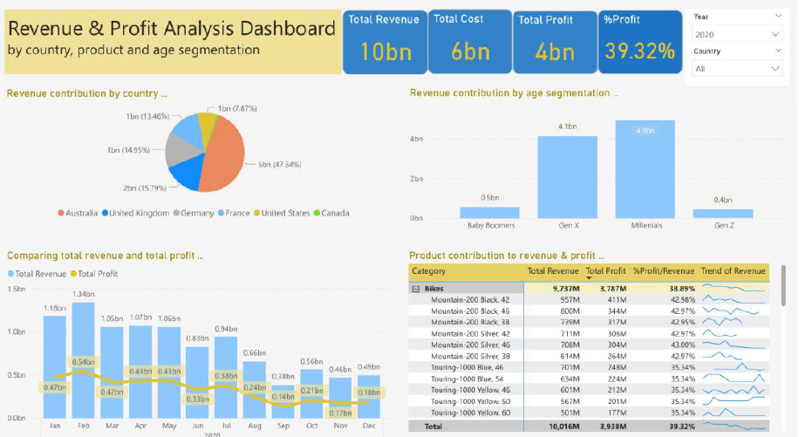
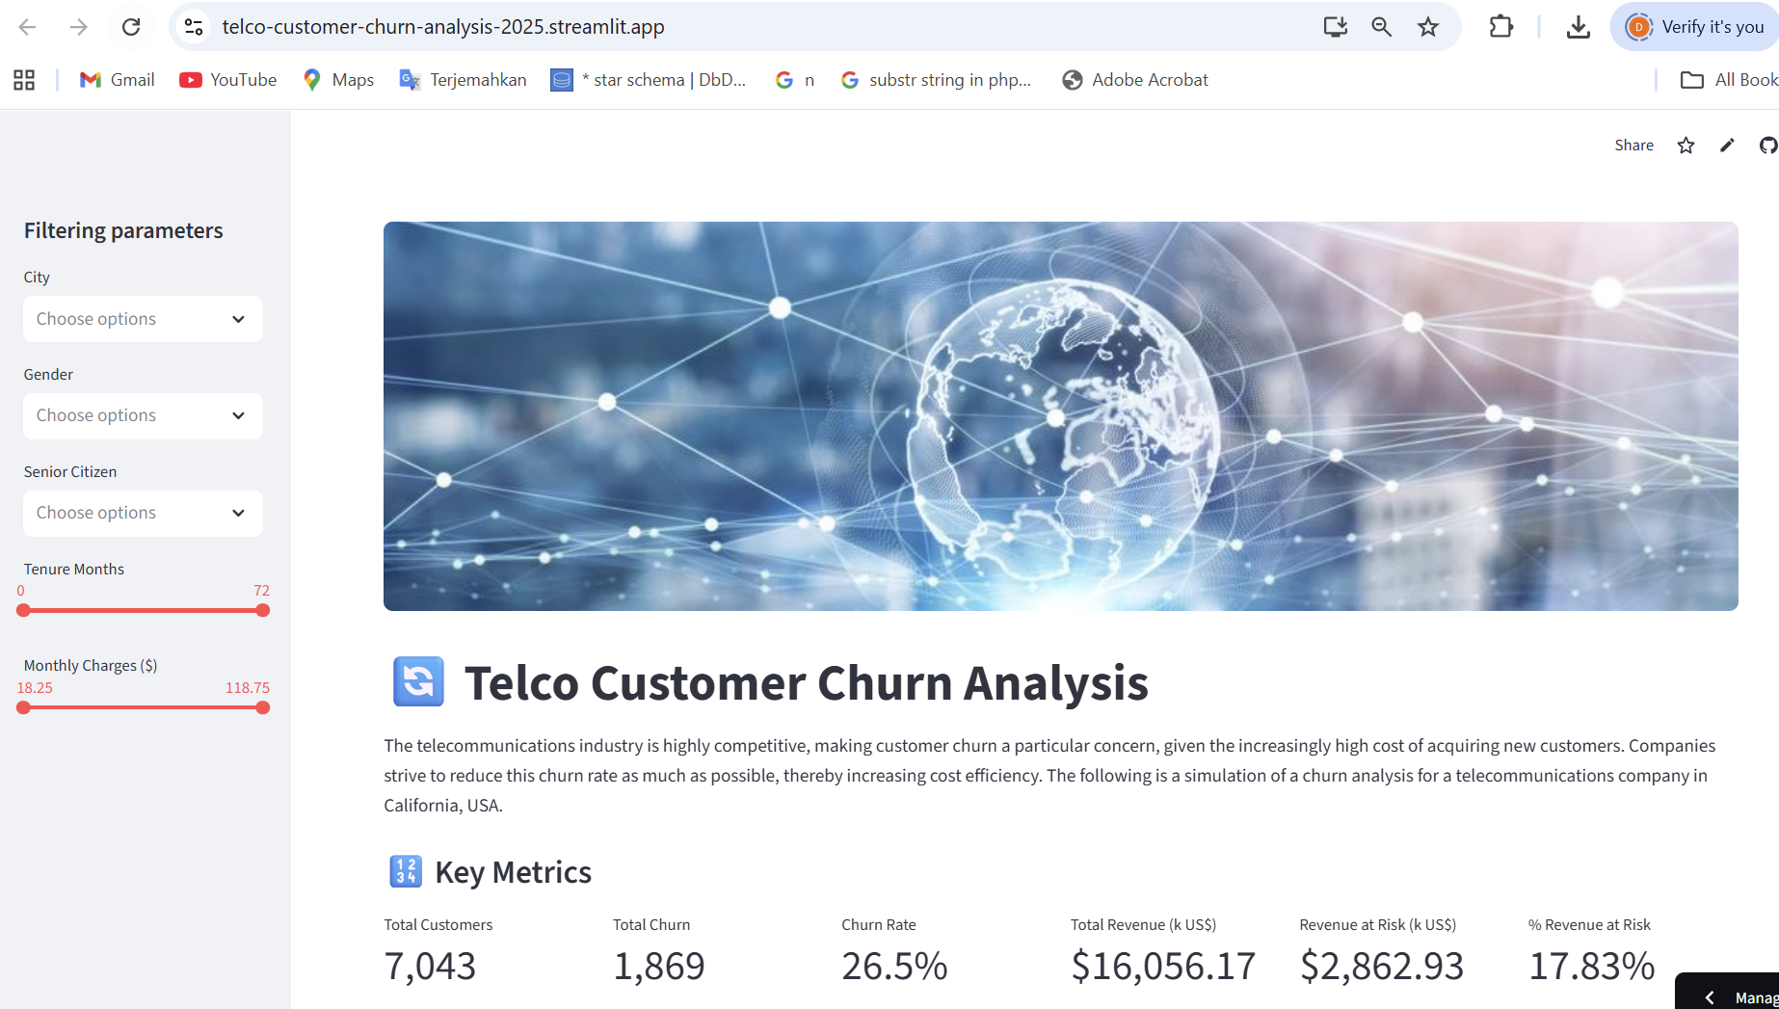
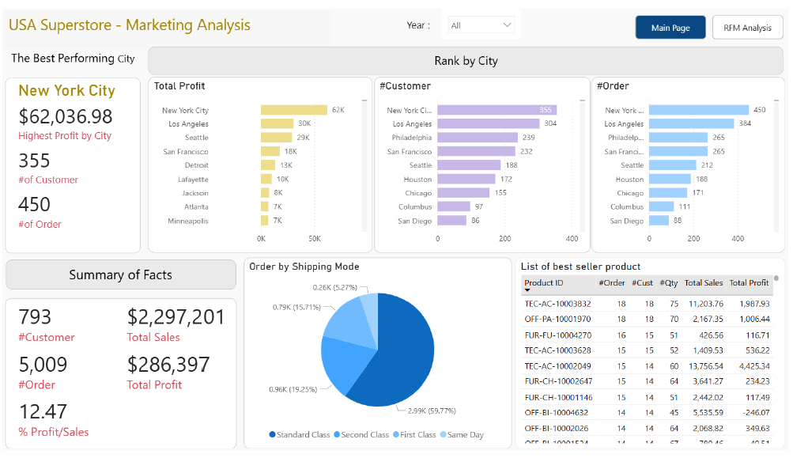
Previous Projects @dibimbing
5
Dashboard of Revenue and Profit Analysis (Power BI)
Dashboard of Marketing Channel Analysis/ RFM Analysis (Power BI)
Telco Customer Churn Analysis (Streamlit)

Slide 6
01
What and Why Obesity?

Slide 7
What is Obesity?
7
“Obesity is the excessive accumulation of fat resulting from a long-term imbalance between energy intake and energy expenditure”
(WHO, 2000)

Slide 8
Obesity – a Global Epidemic
8
7 Alarming Global Facts
No | Key Fact | Main Data (2024)
1 | Global Scale | 1 billion adults obese (16% world population); 43% overweight
2 | Rapid Increase | 2x since 1990; 4x in children/teens
3 | 2035 Projection | 1.53 billion obese (if not prevented)
4 | Annual Deaths | 5 million lives (1 in 8 chronic disease deaths)
5 | Global Cost | Trillions $ (healthcare + lost productivity)
6 | Environmental Crisis | Carbon emissions ↑ = obesity ↑ correlation
7 | WHO Target | Halt obesity & diabetes rise (2025)

Slide 9
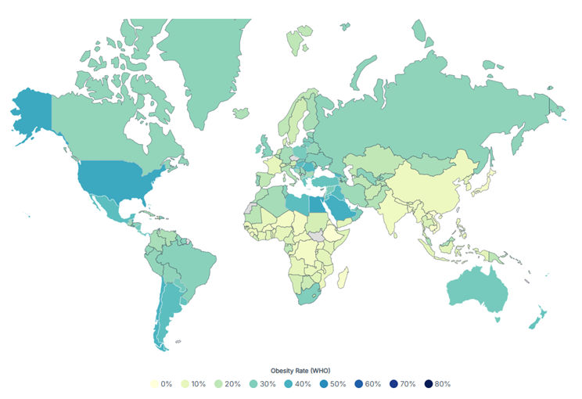
Obesity Rate by Country in 2025
9
Source: https://worldpopulationreview.com/country-rankings/obesity-rates-by-country

Slide 10
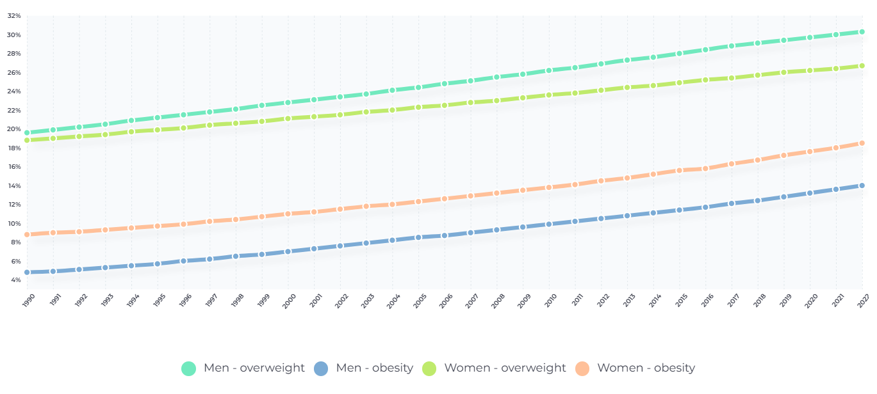
Global Trends in Adult Body-Mass Index
10
Source: https://www.voronoiapp.com/healthcare/Fattest-And-Fittest-Countries-5199

Slide 11
02
Project Background & Problem Statement

Slide 12
Project Background
12
Raise awareness of public health issues related to obesity.
Predict obesity levels using machine learning model.
Develop a Streamlit-based application for real-time predictions.
Beneficiaries: anyone who believes obesity is a global threat to humanity.
Goal: to provide actionable insights based on data and enable users to utilize the predictive application for practical purposes.

Slide 13
Problem Statement
13
Obesity influenced by BMI, dietary habits, daily behavior, family history.
Current methods mostly rely on BMI only → may miss other risk factors.
Objective: build predictive models considering multiple factors.
Identify the best-performing machine learning model.
Success metrics: accuracy, precision, recall, F1-score.
Deliverable: application providing reliable predictions. → Streamlist-based

Slide 14
03
Data Preparation
☑ Data Understanding ☑ Exploratory Data Analysis ☑ Data Preprocessing

Slide 15
Data Understanding

Slide 16
Data Structure
Source File
Source Link
16
ObesityDataSet_raw_and_data_sinthetic.csv
https://archive.ics.uci.edu/dataset/544/estimation+of+obesity+levels+based+on+eating+habits+and+physical+condition

Slide 17
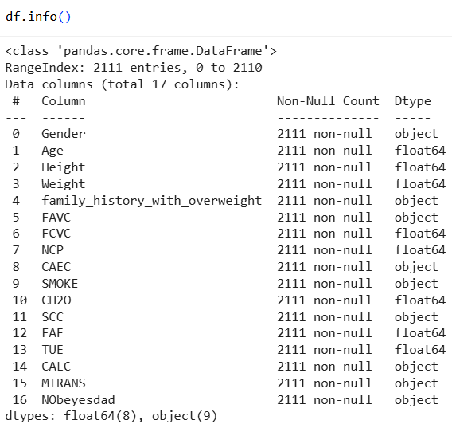
General Info
17
Categorical
Numerical
Gender
FHWO
FAVC
CAEC
SMOKE
SCC
CALC
MTRANS
NObeyesdad
Age
Height
Weight
FCVC
NCP
CH2O
FAF
TUE
features
None of columns contains null values → no imputation required
target

Slide 18
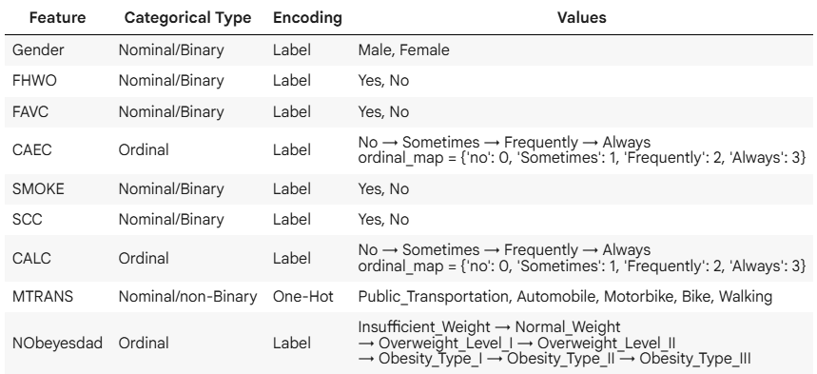
Categorical Column Types
18

Slide 19
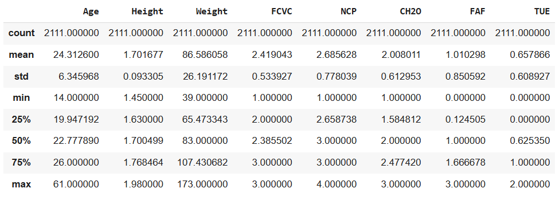
General Statistic
19

Slide 20
Exploratory Data Analysis

Slide 21
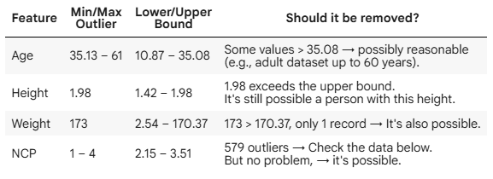
Data Quality
21
Missing Values | Duplicate | Outliers
None | 24
No imputation
Drop duplicate rows
No need to remove outliers

Slide 22
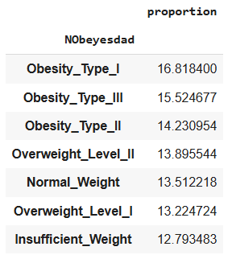
Checking data balance relative to target…
22
The data is relatively balanced across target levels → no data resampling required

Slide 23
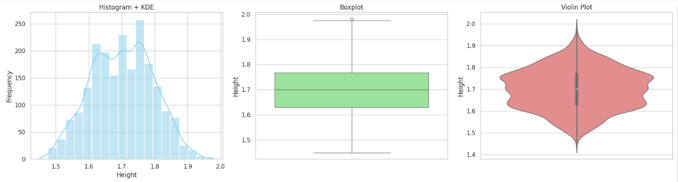
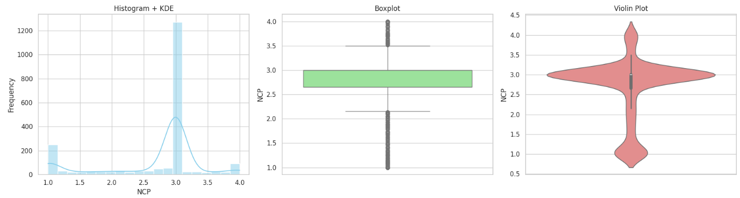
Data Distribution and Outliers Diagram
23

Slide 24
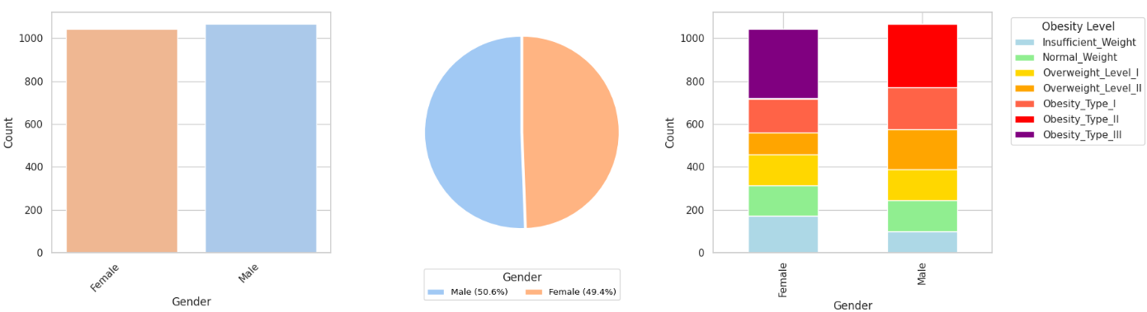
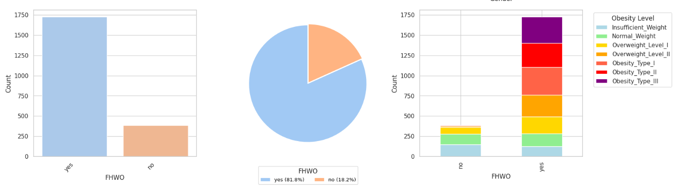
Factors Influencing Obesity Levels
24

Slide 25
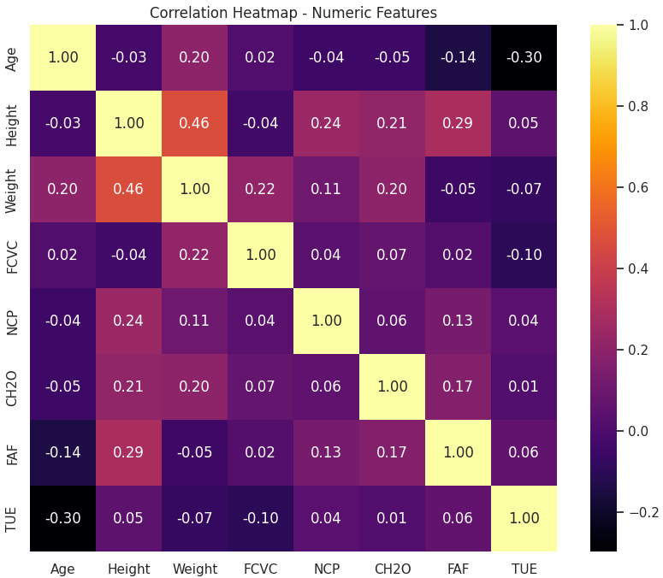
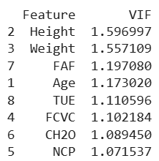
Corr Heatmap and VIF Score: Numerical Features
25
There is no indication that any of the features contain multicollinearity.

Slide 26
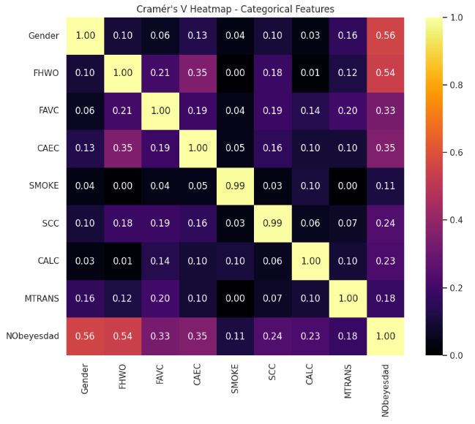
Cramér’s V Heatmap: Categorical Features
26
There is no indication that any of the features contain multicollinearity.

Slide 27
Data Preprocessing

Slide 28
Pipeline
Data Duplicate
Data Selection
Data Scaling
Data Splitting
Data Encoding
28
Drop 24 rows duplicate data
None - No multicollinearity was detected
Using Standard Scaller
1
2
3
4
5
Train : Test
80 : 20
8 : Label encode
1 : One-Hot encode

Slide 29
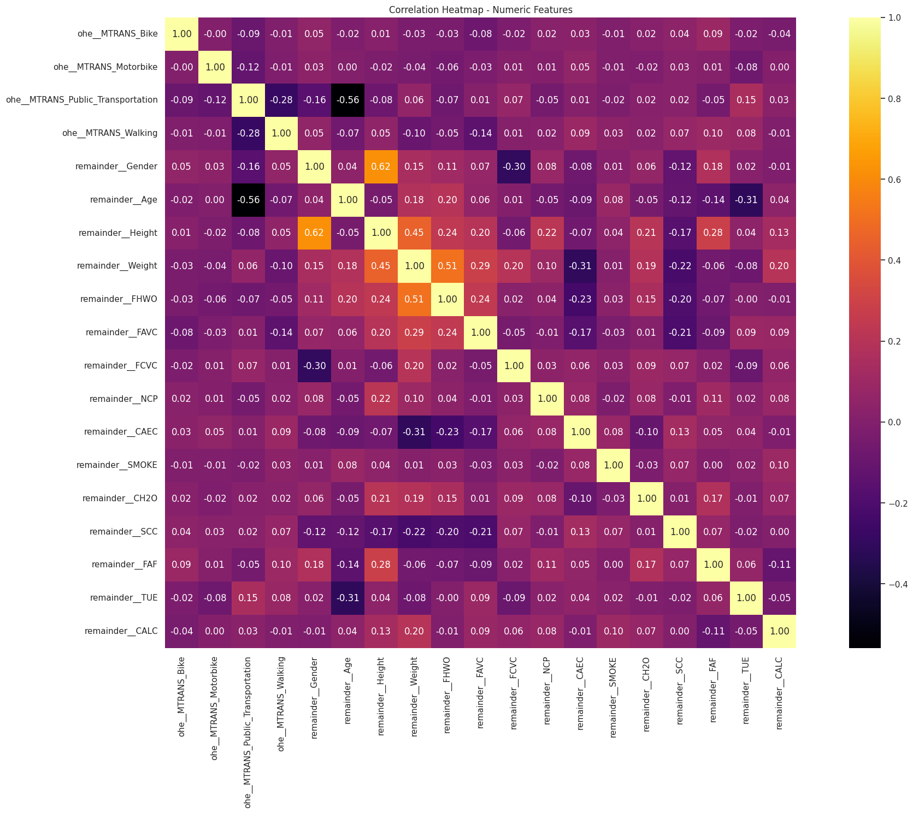
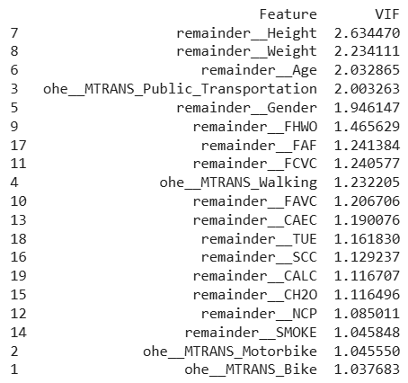
Corr Heatmap and VIF Score: After Scaling
29
There is no indication that any of the features contain multicollinearity.

Slide 30
Data Preparation Summary
30
Size
Class Balance
Rows: 2111 (24 duplicates) → Final: 2087
Columns: 17 (16 features, 1 target)
After encoding: 20 columns (19 features, 1 target)
Data is relatively balanced against the target variable
→ No resampling required
Outliers
Outliers are meaningful
→ No need to remove outlier data
Missing Values
None
Encoding
Data Duplicates
9 categorical columns were encoded
(label = 8, one-hot=1) .
24 rows
Multicollinearity
Scaling
None
→ Corr Heatmap, Cramér’s V Heatmap, VIF Score
Using Standard Scaler,
applied for models using distance-based calculations,
while tree-based models did not require scaling

Slide 31
04
Model Building

Slide 32
Machine Learning Models
32
Model | Python Model | Category | Scaling?
Multinomial Logistic Regression | LogisticRegression (multi_class='multinomial’) | Linear | Yes
Ordinal Logistic Regression | LogisticAT | Linear | Yes
Random Forest | RandomForestClassifier | Tree-based | No required
XGBoost Classifier | XGBClassifier | Tree-based | No required
LightGBM Classifier | LGBMClassifier | Tree-based | No required
CatBoot Classifier | CatBoostClassifier | Tree-based | No required

Slide 33
Model Evaluation Setup
33
Data
Metrics
Train: 1669 (=80%)
Test: 418 (=20%)
Total: 2087 (=100%)
Precision
Recall
F1-Score
Accuracy
Cross Validation
Method: StratifiedKFold, K = 5

Slide 34
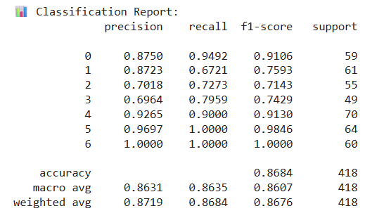
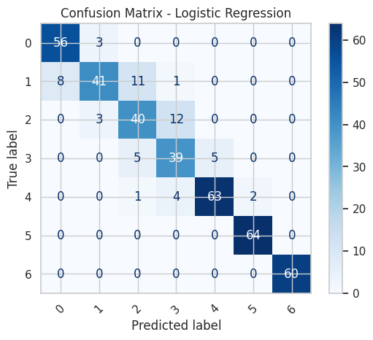
Multinomial Logistic Regression
34
Test & Cross-Validation Accuracy
Test Accuracy: 0.8684
Cross-Validation Accuracy: 0.8610 ± 0.0160

Slide 35
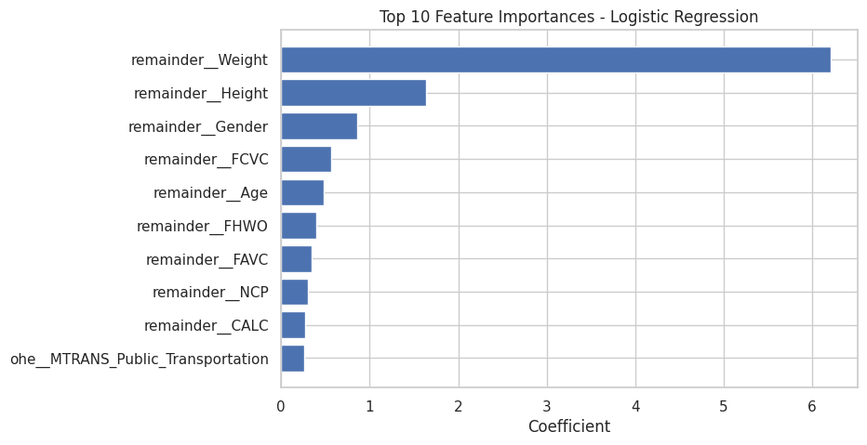
Multinomial Logistic Regression
35
Top Feature Importances

Slide 36
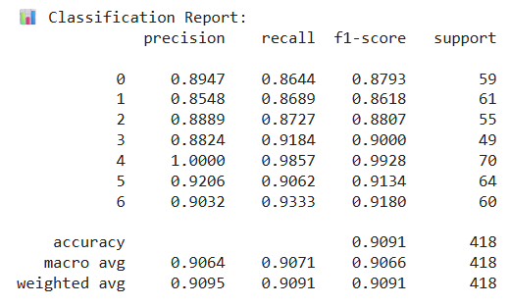
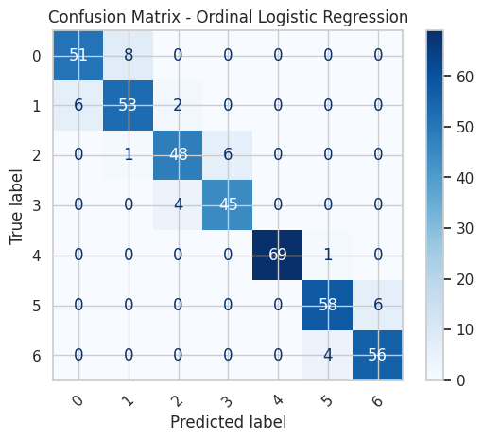
Ordinal Logistic Regression
36
Test & Cross-Validation Accuracy
Test Accuracy: 0.9091
Cross-Validation Accuracy: 0.8993 ± 0.0096

Slide 37
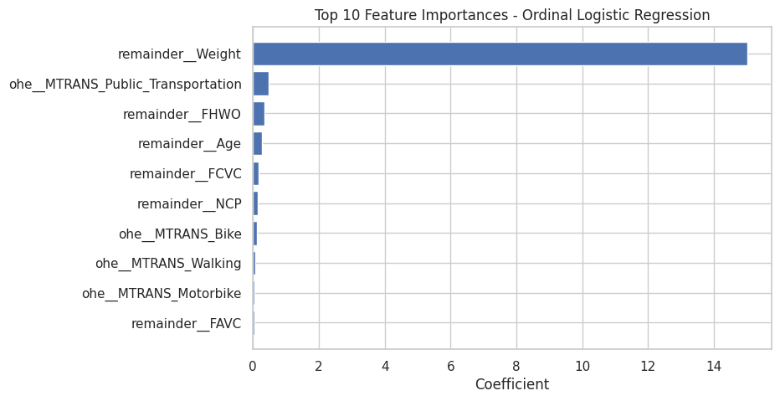
Ordinal Logistic Regression
37
Top Feature Importances

Slide 38
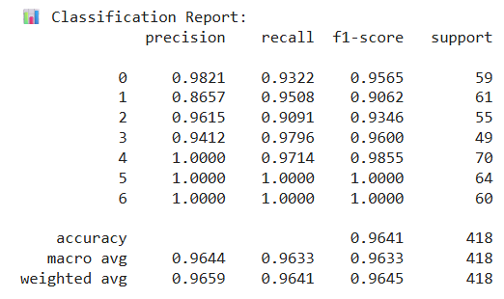
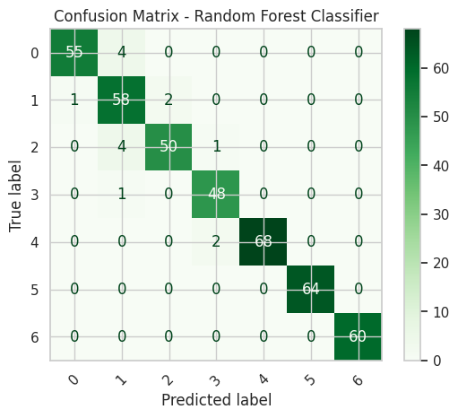
Random Forest
38
Test & Cross-Validation Accuracy
Test Accuracy: 0.9641
Cross-validation accuracy: 0.9461 ± 0.0132

Slide 39
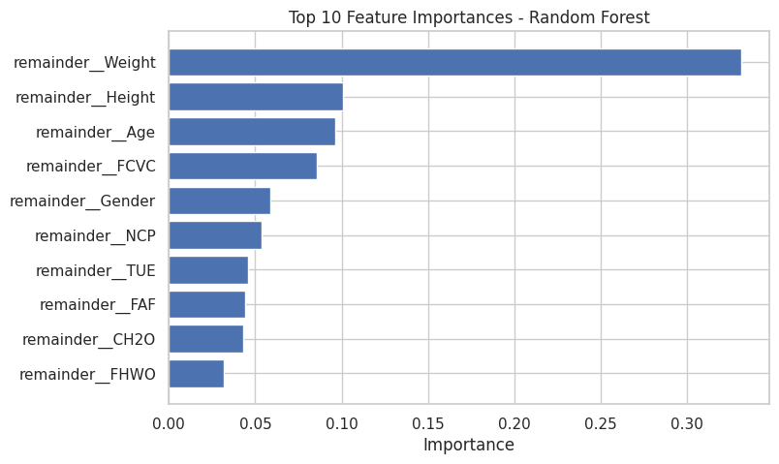
Random Forest
39
Top Feature Importances

Slide 40
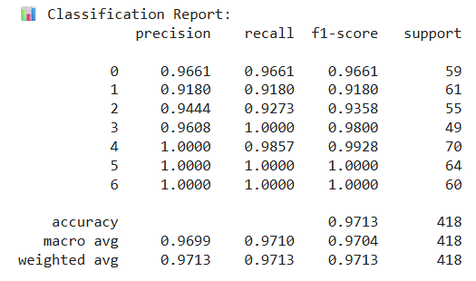
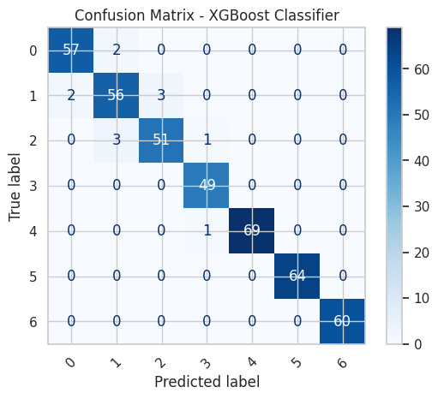
XGBoost Classifier
40
Test & Cross-Validation Accuracy
Test Accuracy: 0.9713
Cross-validation accuracy: 0.9676 ± 0.0035

Slide 41
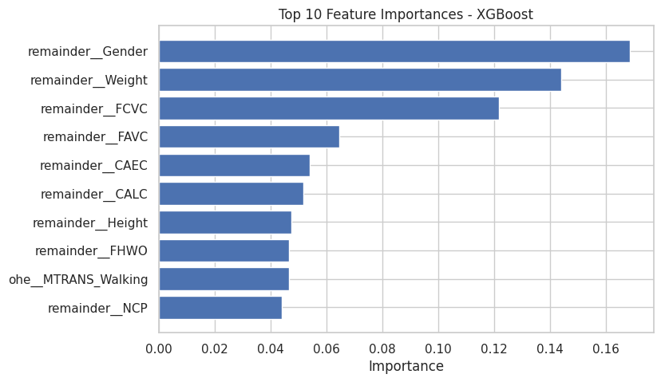
XGBoost Classifier
41
Top Feature Importances

Slide 42
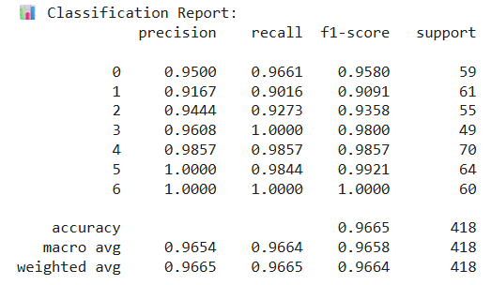
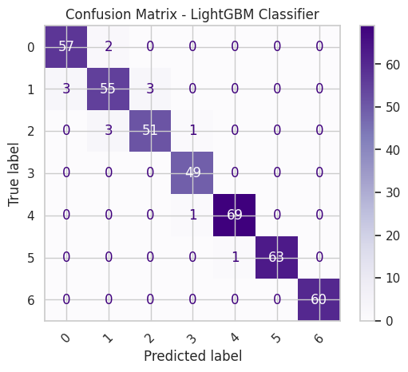
LightGBM Classifier
42
Test & Cross-Validation Accuracy
Test Accuracy: 0.9665
Cross-validation accuracy: 0.9700 ± 0.0033

Slide 43
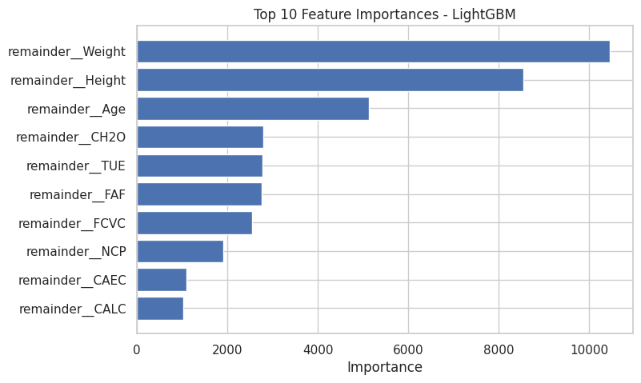
LightGBM Classifier
43
Top Feature Importances

Slide 44
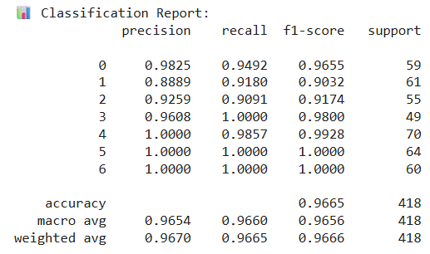
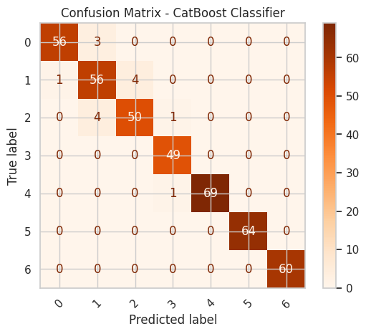
CatBoost Classifier
44
Test & Cross-Validation Accuracy
Test Accuracy: 0.9665
Cross-validation accuracy: 0.9587 ± 0.0087

Slide 45
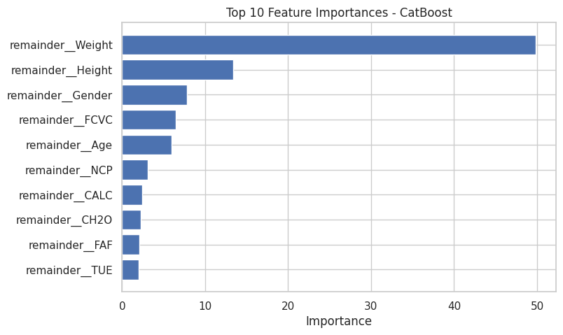
CatBoost Classifier
45
Top Feature Importances

Slide 46

Summary
46
Model | Macro Avg |  |  | Weigthed Avg |  |  | Accuracy | Duration (s)
 | Precision | Recall | F1-Score | Precision | Recall | F1-Score |  | Avg | Min | Max | Range
Multinomial Logistic Regression | 0.8631 | 0.8635 | 0.8607 | 0.8719 | 0.8684 | 0.8676 | 0.8684 | 1.70 | 0.90 | 3.20 | 2.30
Ordinal Logistic Regression | 0.9064 | 0.9071 | 0.9066 | 0.9095 | 0.9091 | 0.9091 | 0.9091 | 1.38 | 1.20 | 1.80 | 0.60
Random Forest | 0.9644 | 0.9633 | 0.9633 | 0.9659 | 0.9641 | 0.9645 | 0.9641 | 8.06 | 6.10 | 14.10 | 8.00
XGBoost Classifier | 0.9699 | 0.971 | 0.9704 | 0.9713 | 0.9713 | 0.9713 | 0.9713 | 10.78 | 10.40 | 11.20 | 0.80
LightGBM Classifier | 0.9654 | 0.9664 | 0.9658 | 0.9665 | 0.9665 | 0.9664 | 0.9665 | 11.80 | 10.20 | 13.10 | 2.90
CatBoost Classifier | 0.9654 | 0.966 | 0.9656 | 0.967 | 0.9665 | 0.9666 | 0.9665 | 29.68 | 28.20 | 31.90 | 3.70
Conclusion on Baseline
XGBoost achieved the highest accuracy (97.13%) and the best F1-scores, making it the top-performing model.
LightGBM and CatBoost also performed well (~96.65% accuracy), slightly below XGBoost.
Random Forest offered good accuracy (96.41%) with faster training time.
Multinomial Logistic Regression and Ordinal Logistic Regression were faster but less accurate.
Overall, XGBoost provides the best balance between accuracy and training time. → Champion of Baseline, before tuning

Slide 47
Hyperparameter Tuning
47
*) Tuning using OPTUNA with trials=100
Conclusion after Tuning
LightGBM was the most effective model, achieving the highest accuracy (97.18%) and the best improvement over its baseline (+0.53%), all in the shortest time.
XGBoost was slightly less accurate and much slower, while Random Forest's performance degraded after tuning.
CatBoost failed to complete because it was taking too long.

Slide 48
05
Streamlit App Development

Slide 49
Application Design
49
Side bar input parameter
Banner
Title
Tab menu
Info area
Button to execute prediction
Prediction Result
And other info

Slide 50
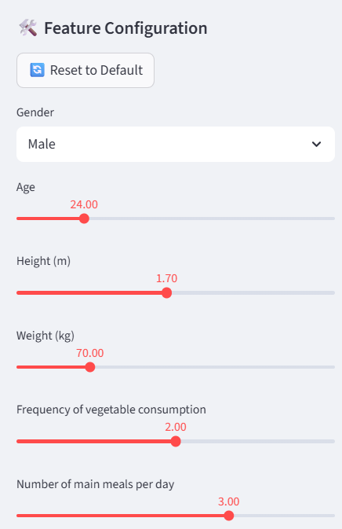


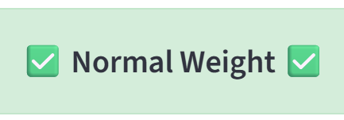
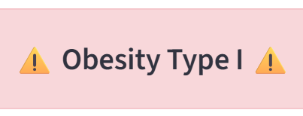
Application Workflow
50
User input parameters
Execute (Press button)
Model Processing
Display Result

Slide 51
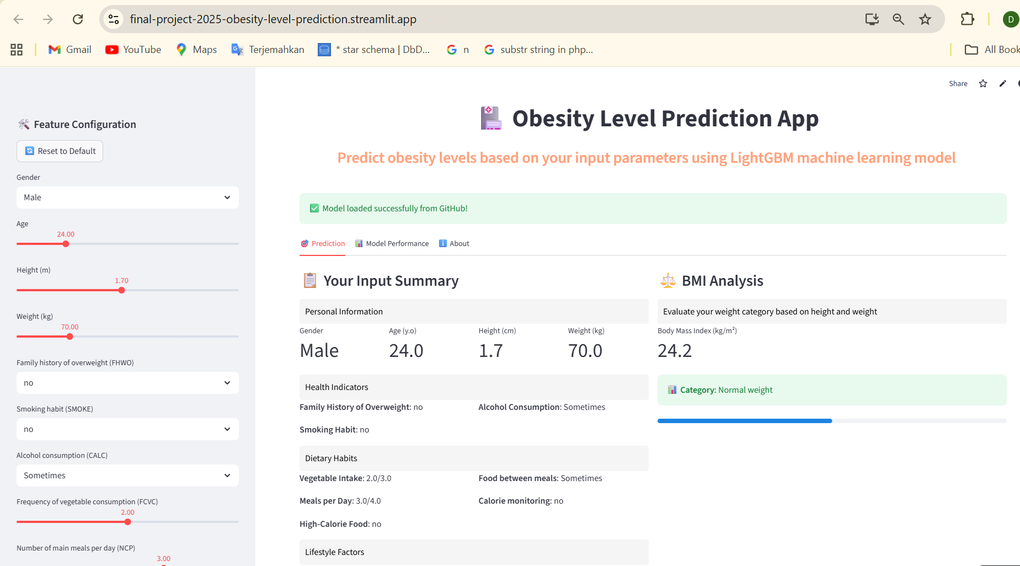
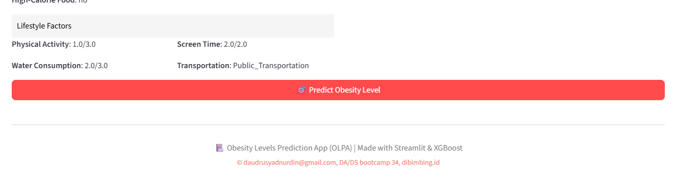
Obesity Level Prediction App
51
1
Input parameter here
2
Press this red button

Slide 52
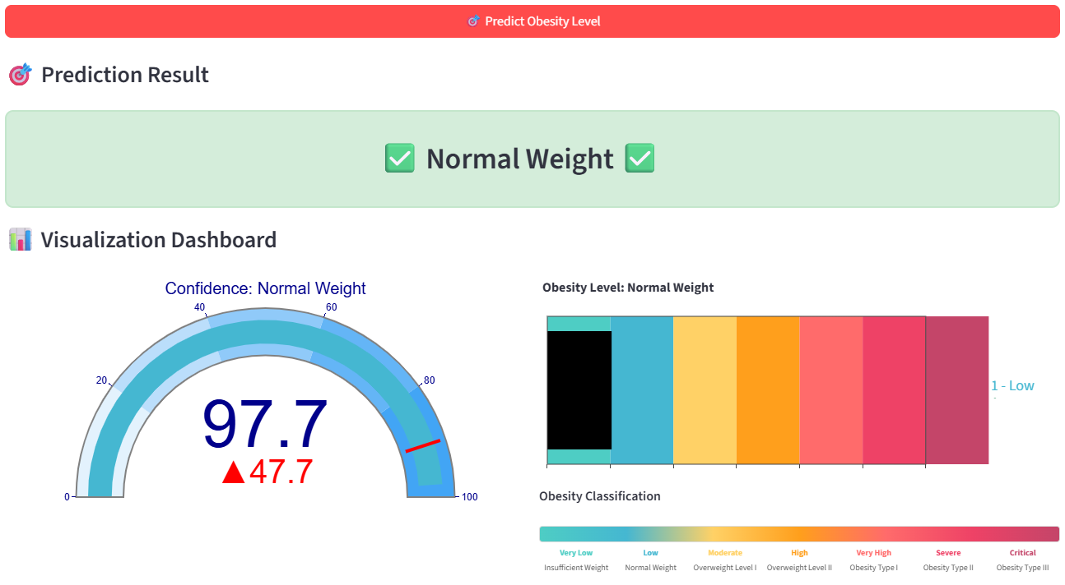
Obesity Level Prediction App
52
3
Check the result here

Slide 53
06
Conclusions and Business & Actionable Insights

Slide 54
Conclusions
54
Model Exclusion: Logistic Regression models were excluded due to substantially lower initial accuracy.
Pre-Tuning Leader: XGBoost was the initial top performer based on baseline scores.
Post-Tuning Champion: LightGBM showed the most substantial improvement after tuning, achieving the highest final accuracy.
Final Selection: The tuned LightGBM model was chosen for the Streamlit prediction app.

Slide 55
Business Insight
55
In general, the models indicate that Weight, Height, Age, and Gender are the primary factors contributing to obesity. These variables consistently showed strong correlations with obesity levels across multiple model evaluations.
Furthermore, the LightGBM model — which was selected as the best-performing algorithm due to its high predictive accuracy and computational efficiency after hyperparameter tuning — identified several additional key determinants of obesity, namely:
Dietary Patterns
Daily water intake
Vegetable consumption frequency
Meal frequency
Snacking habits
Lifestyle Factors
Physical activity level
Technology usage frequency
Alcohol consumption frequency
These findings suggest that, in addition to physical attributes, dietary pattern and lifestyle factors collectively play a crucial role in determining obesity risk.

Slide 56
Actionable Insights
56
01
03
Promote Balanced Nutrition Encourage individuals to reduce high-calorie and snack consumption while increasing vegetable intake to maintain a healthy weight.
Raise Awareness of Lifestyle Habits Educate users on the impact of alcohol consumption, meal frequency, and transportation choices (e.g., sedentary commuting) on obesity risk.
Support Preventive Health Programs Leverage model insights to design community-based interventions focusing on diet improvement and active mobility.
Integrate Predictive Apps into Daily Use Enable users to apply the predictive application for self-assessment and continuous monitoring of their obesity risk.
02
04

Slide 57

My files to share…
57
https://github.com/daudrusyadnurdin/final-project-2025

Slide 58
Thank you!

